Slide 1
Fintech Project 1
Interactive dashboard planning tool
Tian Tran
Luke Konstantopoulos
Alvin Yau
Yohei Waki

Slide 2
About the project
The purpose of this project is to build a retirement portfolio planning tool that allows users to view both historical and risk analysis data through various vidualised plots which helps them make a noble decision. The historical data of US shares and crypto currencies over the past 3 years period have been used to determine our analysis.
Type of analysis to determine the performance & forecasts include Daily returns, Cumulative returns, Standard Deviation, Sharpe ratio, Rolling Beta, and Monte Carlo simulation.

Slide 3
Determination stages
Plan
Preparation of Data
Coding & Computing
Implementation and debug

Slide 4
Planning stage
Select API to retrieve practical data.
US shares and crypto as a subject of investment.
Choose analytical method to be included into the visualisation portfolio.
Planning how the dashboard will look like.
Explore and outline ideas. Perform research for the dataset.

Slide 5
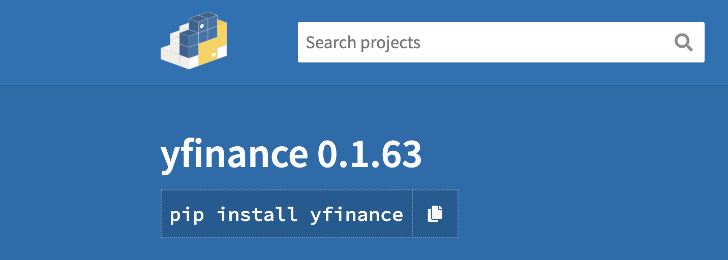
Preparation of Data
Pulling financial data from a ‘Yahoo! Finance’
‘Yfinance formated the data into a tabular format with multi-level index column.
Chose 10 Crypto, 10 stocks and SP500 & USDT as benchmark comparison.
Scope and limitation

Slide 6
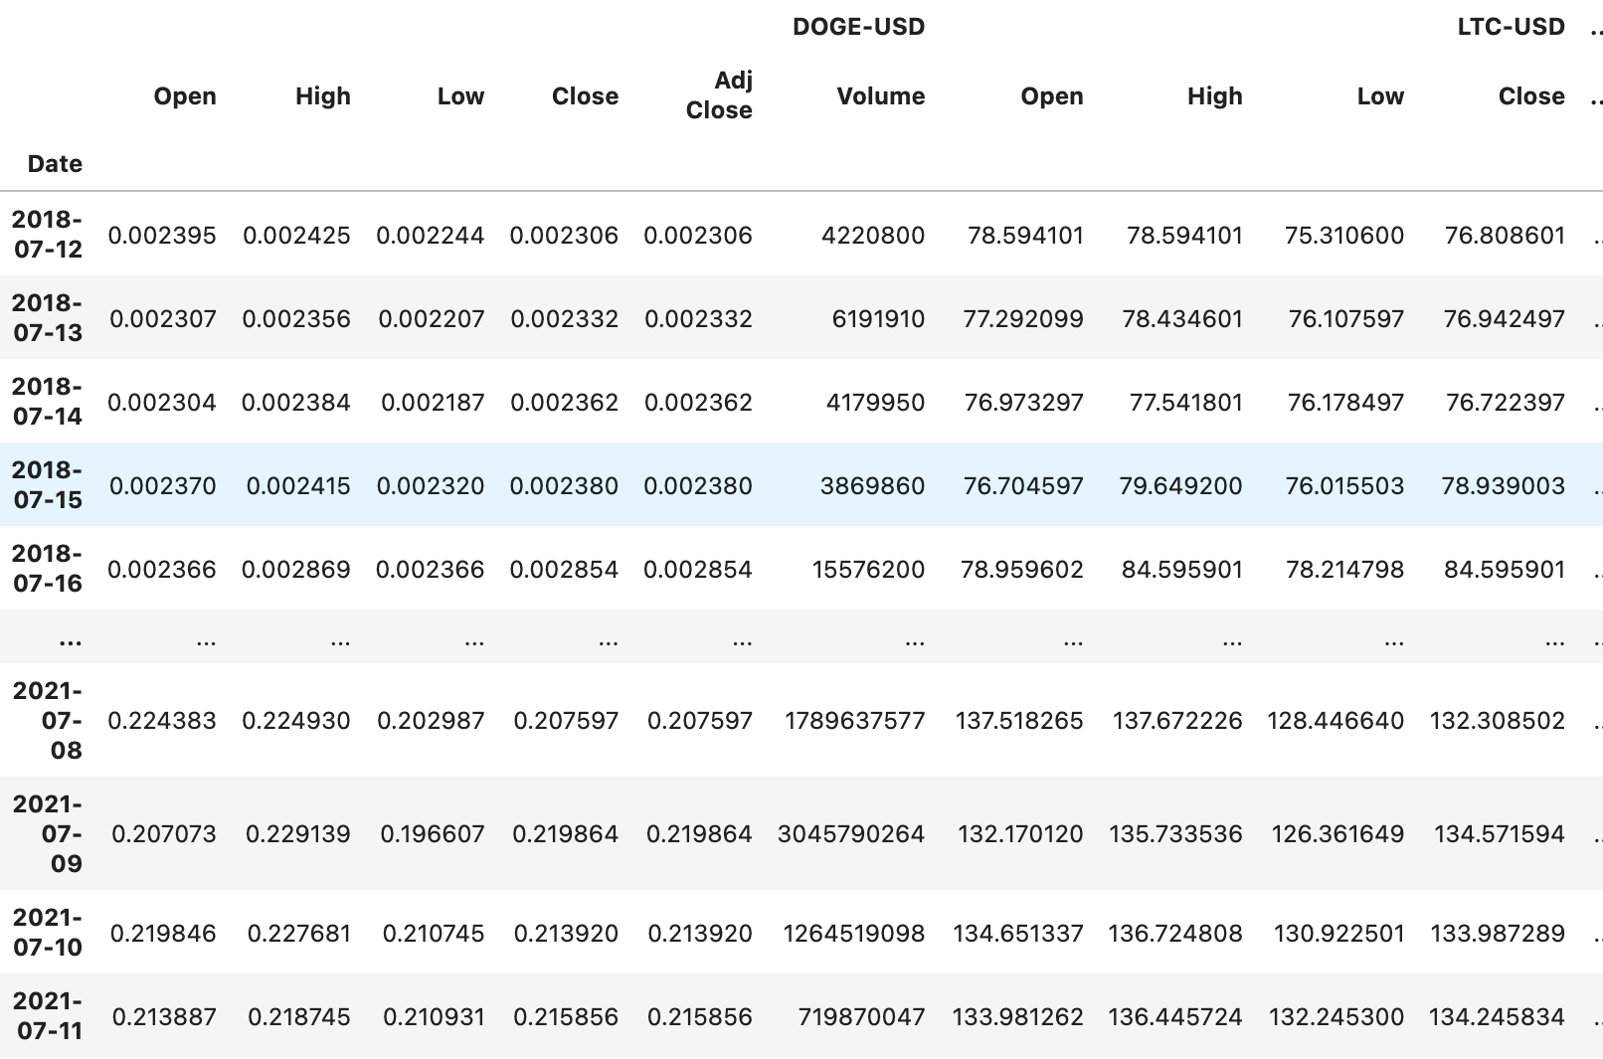

Slide 7
Coding and Computing
Data acquired from “Yahoo finance”.
Clean and process data in a sequential order and display.
Keep the code in logical order with pseudocode to explain each function and input.
Use pandas to
Clean and format data
Pseudocode and be logical

Slide 8
Implementation and debug
Run through each cell to confirm all the data frames and plots are displayed without any errors.
Confirm readability of the dashboard and run each tabs to see they are working.
Be practical in use and stay minimum with changes required.
Inputs, Data Frame, plots, and functions.
Dashboard display and readability.

Slide 9
Modification of MCforecast.ny
MCforecast.ny that was provided prior unit in our course
MCforecast.ny has been modified to read in the Yfinance dataframe format
MCforecast tool has also been modified to produce hvplot charts output rather than the original pandas plot.

Slide 10
Historical Tab

Slide 11
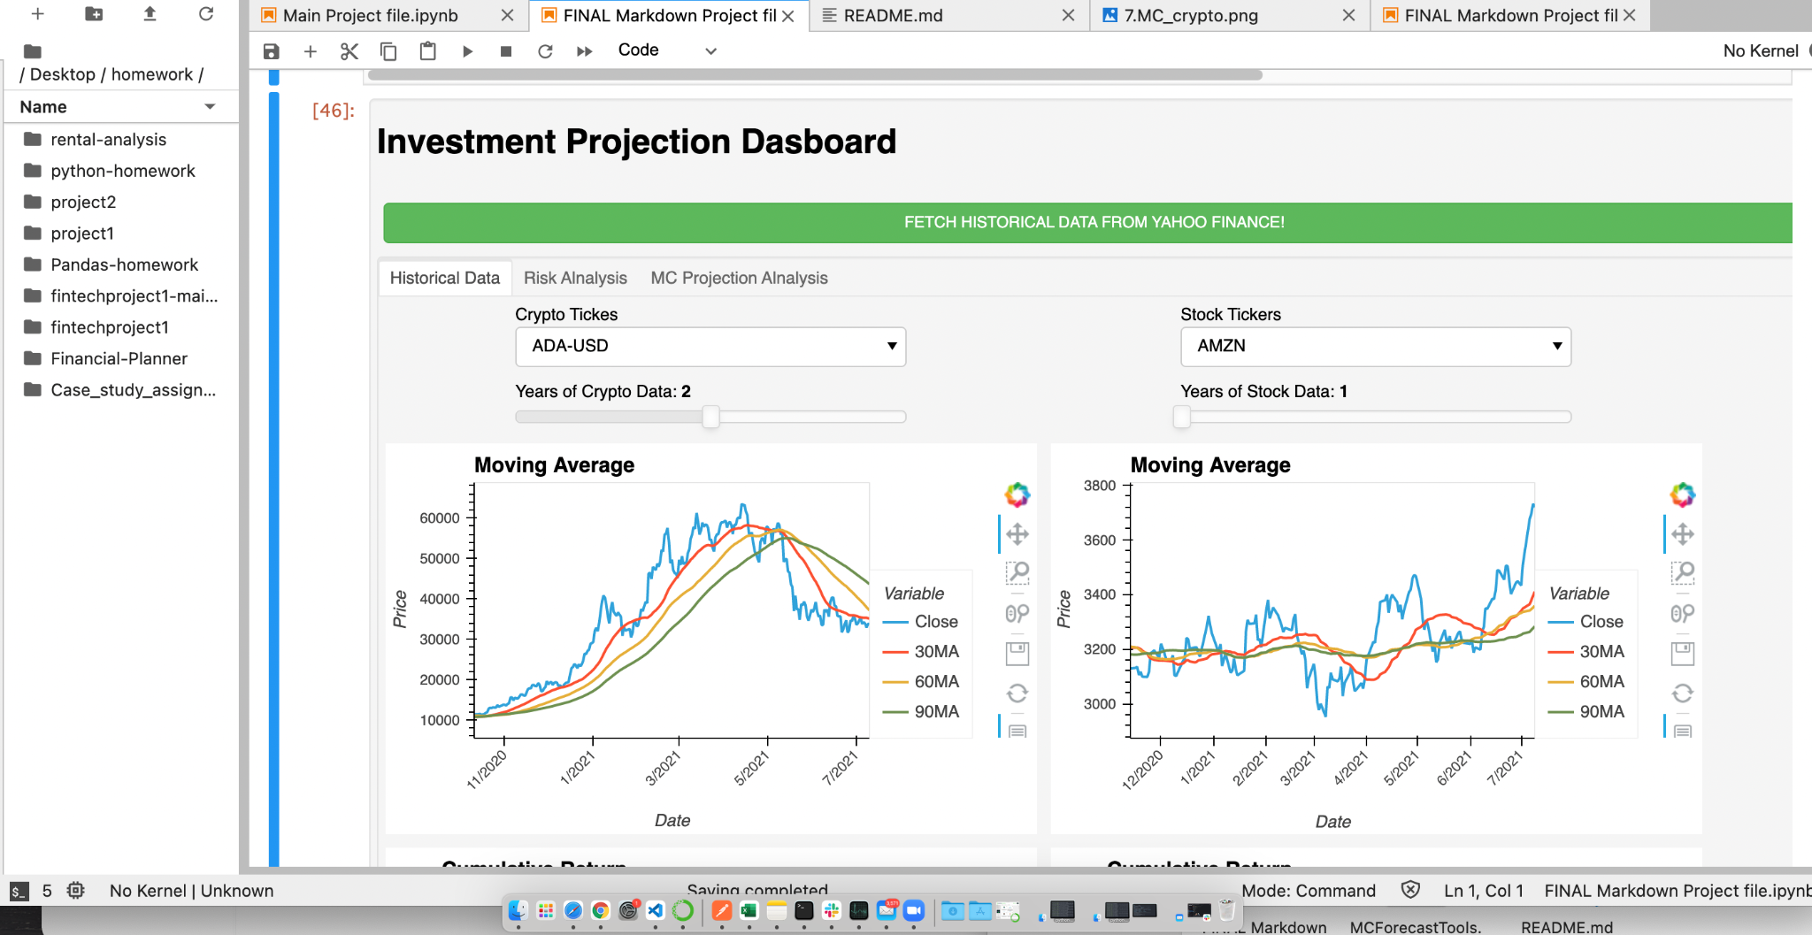


Historical Portfolio tab
The historical tab allows users to view the historical performance of both US shares and crypto.
Users can select from a dropdown and slide menu to view Moving Average and Cumulative return. Shares are displayed on the left and crypto on the right side of the screen.

Slide 12
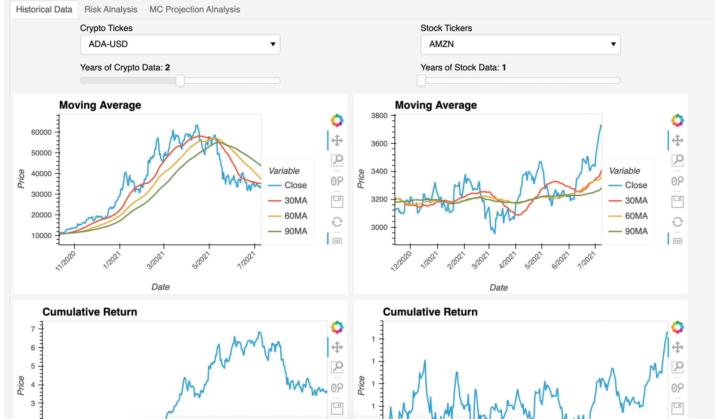

Slide 13
Risk Analysis Tab

Slide 14
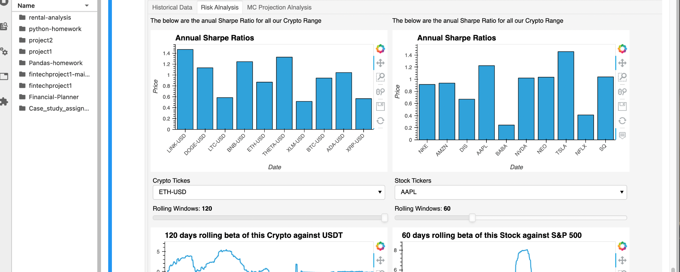
Risk Analysis tab
The risk analysis tab allows users to see sharpe ratio of all stocks and cryptos available.
Users can also see the rolling beta of single stock or crypto against the benchmark of S&P500 and USDT.

Slide 15
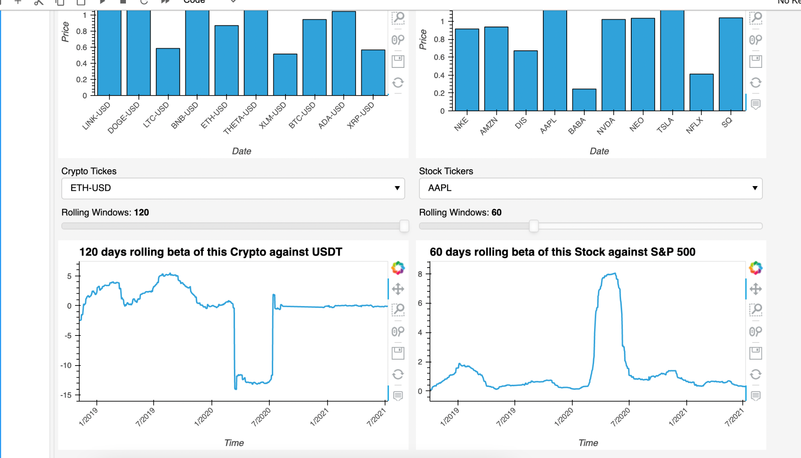

Slide 16
MC Projection Analysis Tab

Slide 17
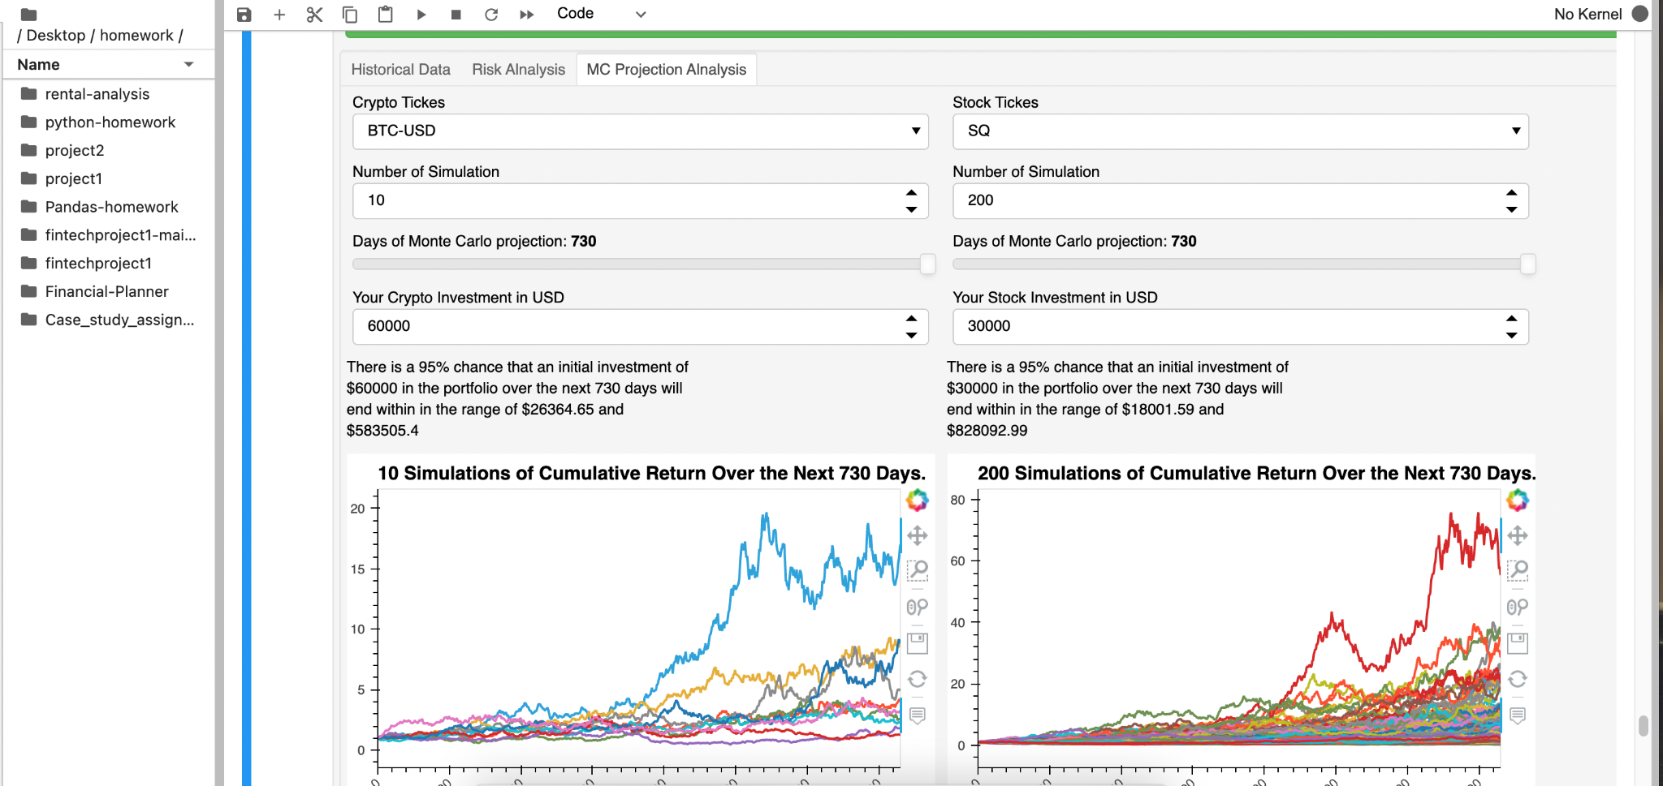
MC Projection Analysis tab
The MC Projection Analysis tab allows users to see stock and crypto projections based on Monte Carlo Simulations.
Users can select tickers, number of simulations (10 to 1000), days of MC projection (1 or 2 years) and initial investment amount in USD and simulate the result of investment over the period.

Slide 18
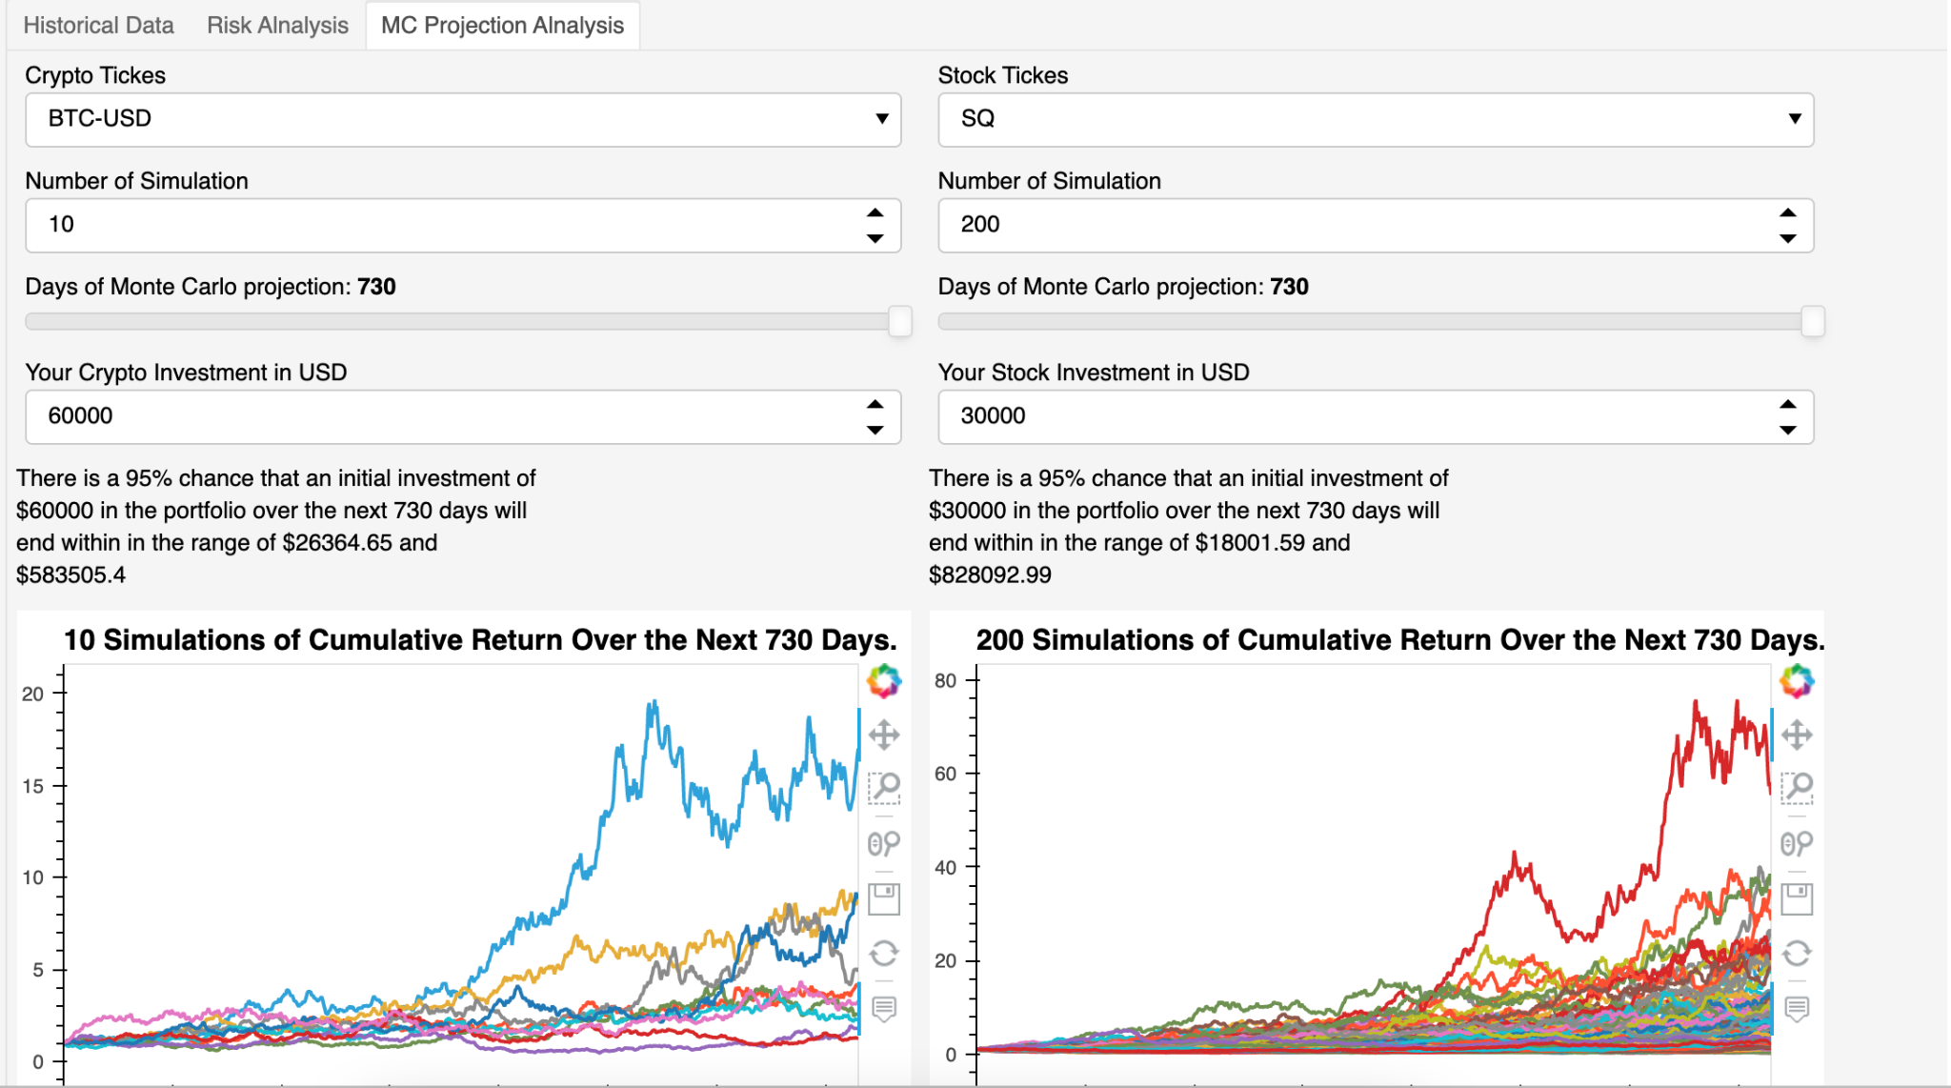

Slide 19
Contributors
Tian
Luke
Alvin
Yohei

Slide 20

Questions?

